Slide 1
Image Enhancement
Prof. Eric Miller
elmiller@ece.tufts.edu
Fall 2009
EN 74-ECE Image Processing
Lecture 4-<number>

Slide 2
Overview
Basic problem in image processing: making images look better
All sorts of degradations that can cause problems
  Blue
  Noise
  Bad contrast
Here we deal with the last
  Pixel-by-pixel modifications to bring out the “detail” in images with poor contrast
  Technical term: “Contrast enhancement”
Fall 2009
EN 74-ECE Image Processing
Lecture 4-<number>

Slide 3
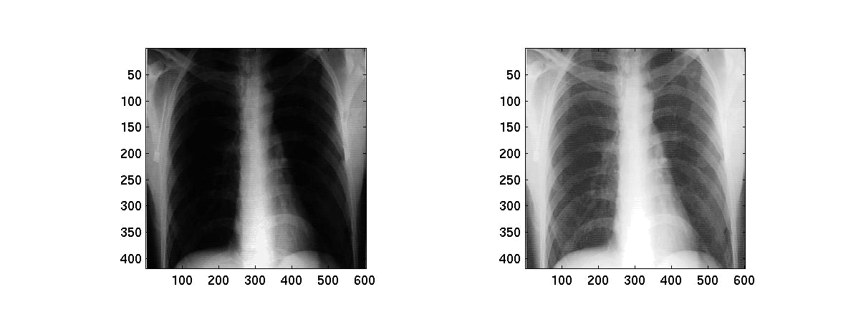
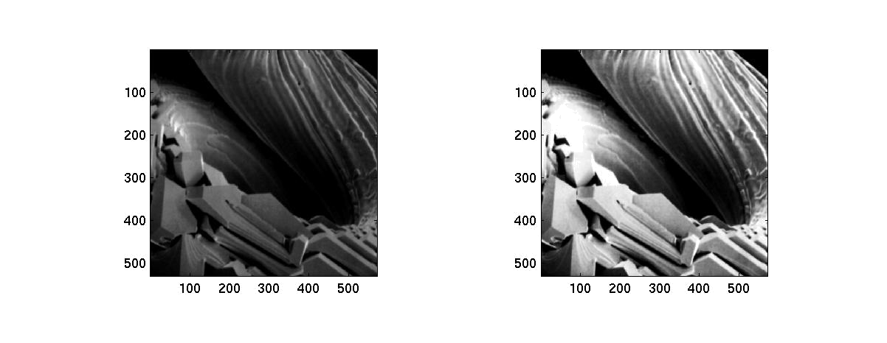
Some examples
Input
Output
Fall 2009
EN 74-ECE Image Processing
Lecture 4-<number>

Slide 4
Basic Program
Everything we do here amounts to pixel-by-pixel transformation of gray value
Output gray value
Input gray value
Transformation
s
T(r)
Qualities of T
Domain?
Range?
r
Fall 2009
EN 74-ECE Image Processing
Lecture 4-<number>

Slide 5
Image Negative
Image negative means we make black white and white black
Black = 0 and white = 255
What about in between? Maybe just a line
s
255
r
255
Fall 2009
EN 74-ECE Image Processing
Lecture 4-<number>

Slide 6
Stretching contrasts
s
255
Narrow range or dark shades get stretched out to fill a much broader range of gray values
If image is very dark so small variations are tough to tell apart then this will improve the contrast
Common choice for this function
Choose c so that s=0 at r=0 and s=255 at r=255. What should it be?
r
255
Fall 2009
EN 74-ECE Image Processing
Lecture 4-<number>

Slide 7
Piecewise linear stretch
s
Different gray values get stretched in different ways
Transform completely specific by the “breakpoints” (r_{j},s_{j}) j=1,2,…,N
Restrictions on these?
Idea would be to choose these breakpoints in some “optimal” way.
255
s₃
s₄
s₁
s₂
r
r₁
r₂
r₃
r₄
Fall 2009
EN 74-ECE Image Processing
Lecture 4-<number>

Slide 8
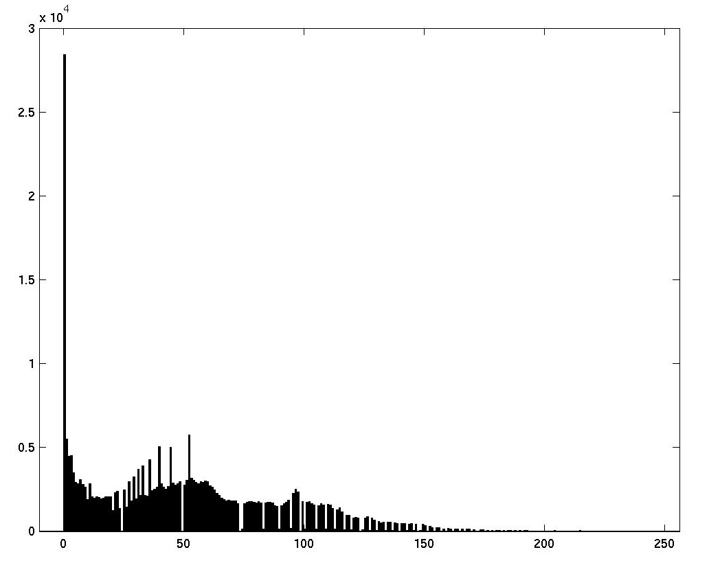
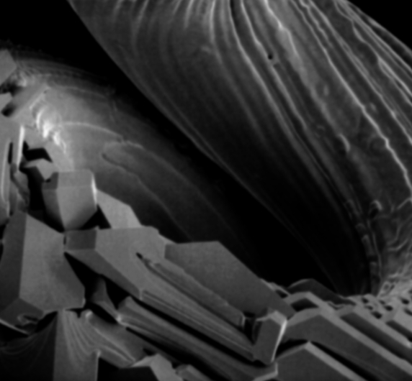
Histogram equalization
Image histogram
Dark image means lots of gray levels near zero
Histogram skewed to the left
Wouldn’t it be better if we could use all of the gray levels sort of equally?
In that case we would have a flat histogram
So, let’s find a T that flattens the histogram!
Number of
occurrences
Gray levels (0 - 255)
Fall 2009
EN 74-ECE Image Processing
Lecture 4-<number>

Slide 9
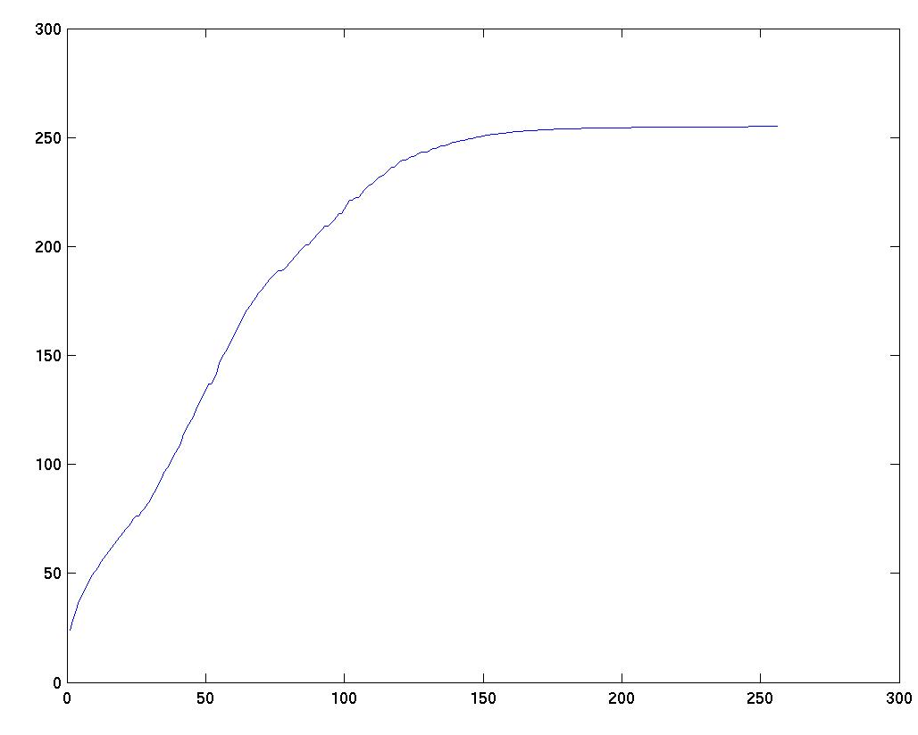
Why does it work?
Kind of like the log transformation
Rapid rise to stretch out the dark
Plateau to deal with the light
For continuous images this will exactly give us flat histogram
For discrete, only approximate
T(r)
s
r
Fall 2009
EN 74-ECE Image Processing
Lecture 4-<number>

